Slide 1
Chapter 8--Overview
How fast can we sort?
  The lower bound of comparison based sorting
Non comparison sort -- radix sort in linear time
Comparison sorting
  The only operation to decide the order of keys is comparison of pairs of keys.
  All sorts seen so far are comparison sorts: insertion sort, selection sort, merge sort, quick sort, heap sort.

Slide 2
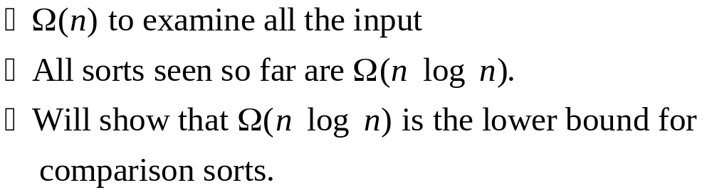
Lower bounds for sorting
A lower bound vs. THE lower bound

Slide 3
Two facts
Suppose n input keys → n! possible outputs
For a binary tree with m leaves, the height is >=

Slide 4
Decision tree
Abstraction of any comparison sort
  A node: corresponds a comparison
  Two branches: correspond to yes and no cases
  A leaf: corresponds to a permutation of inputs
Represents comparisons made by
  a specific sorting algorithm on inputs of a given size.
Abstracts away everything else: control and data movement.
We’re counting only comparisons.

Slide 5
Decision tree of insertion sort on 3 elements
Each internal node is labeled by indices of array elements from their original positions.
Each leaf is labeled by the permutation of orders that the algorithm determines.

Slide 6
Decision tree of merge sort on 3 elements

Slide 7
Basic idea of proving lower bound
How many leaves on the decision tree?
#comparisons of the worst case?
Height of a binary tree with leaves

Slide 8

Theorem
Any decision tree that sorts n elements has height
Proof
Corollary -- merge sort is asymptotically optimal comparison sort.

Slide 9

Non-comparison sorts -- Counting sort
Depends on a key assumption: numbers to be sorted are integers in {0...1......,k }.
Input: A[1 ..n], where
  A[ j ] {0...1......,k } for j =1...,n.
  A, n and k are given as parameters.
Output: B[1 ..n], sorted.
  B is assumed to be already allocated.
Auxiliary storage: C[0 ..k]

Slide 10
The Counting sort algorithm
COUNTING-SORT (A, B, n, k)
Let C[0..k] be a new aray
for i = 0 to k
C[i] =0
for j =1 to n
C[ A[ j]] =C[ A[ j]] +1
for i =1 to k
C[i] =C[i] +C[i -1]
for j =n down to 1
B[C[ A[ j]]] =A[ j]
C[ A[ j]] =C[ A[ j]] -1
Example:

Slide 11

Analysis
Counting sort is stable
  keys with same value appear in same order in output as they did in input
Running time complexity:
Counting sort will be used in radix sort where k=10

Slide 12
Radix sort
Key idea: Sort least significant digits first by counting sort
To sort keys with d digits:
RADIX-SORT (A,d)
for i =1 to d
use counting sort to sort array A on digit i
Example:

Slide 13
Correctness
Induction on number of passes (i in pseudocode).
Assume digits 1, 2,...,i -1 are sorted.
Show that a stable sort on digit i leaves digits 1,...,i sorted:
  If 2 digits in position i are different, ordering by position i is correct, and positions 1,...,i -1 are irrelevant.
  If 2 digits in position i are equal, numbers are already in the right order (by inductive hypothesis). The stable sort on digit i leaves them in the right order.
This argument shows why it’s so important to use a stable sort for intermediate sort.

Slide 14



Analysis
per pass (digits in range 0,...,k)
d passes
total
If
What is d?

Slide 15
Summary
Lower bound for comparison based sorting algorithms
Counting sort
Radix sorting

